Slide 1
Class 5
NED PGD DS w/AI Batch 3/4

Slide 2
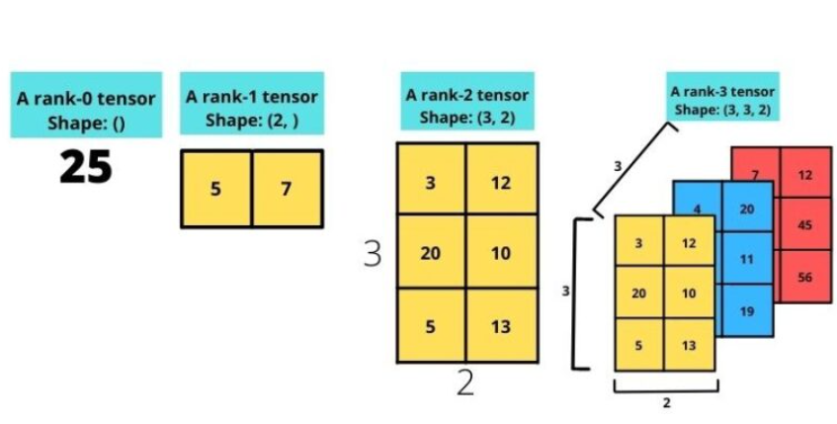
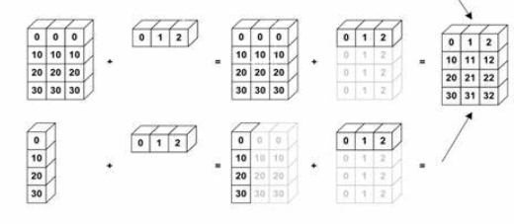
The concepts Learnt in previous classes
Tensors
Rank 0 tensors = Scalers
Rank 1 tensors = Vectors = 1D Array
Rank 2 tensors = Matrix = 2D array
Rank 3 tensors = 3D arrays
Rank n tensors = nD array
Tensor Operations we need to know: - Dot Product - Addition - Transpose
Broadcasting in addition

Slide 3
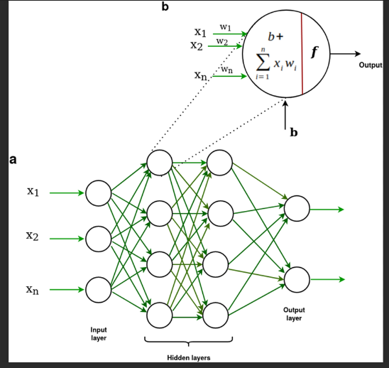
The concepts Learnt in previous classes
Neural Netwoks: Input,Hidden,Output Layers
Forward pass (upto calculation of loss function), and application of activation function.
Backpropagation (backward pass) - calculation of gradients, updating weights.
Layer Class (units, weights initialization, activation function)

Slide 4
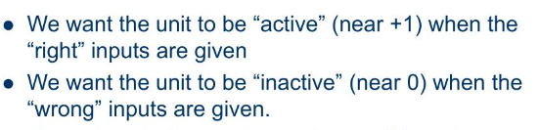
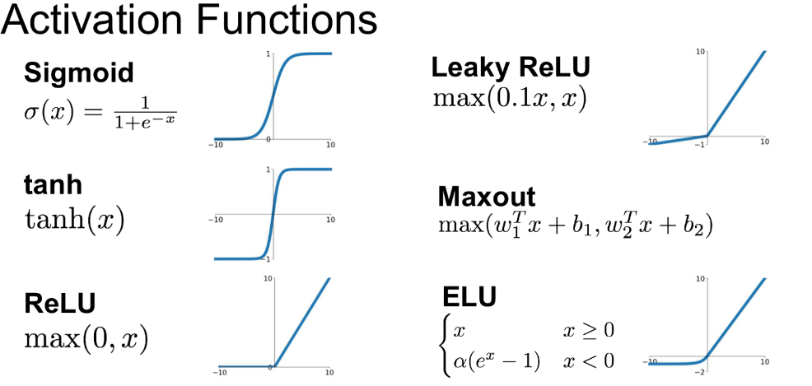
Relu activations can solve a wide range of problems

Slide 5
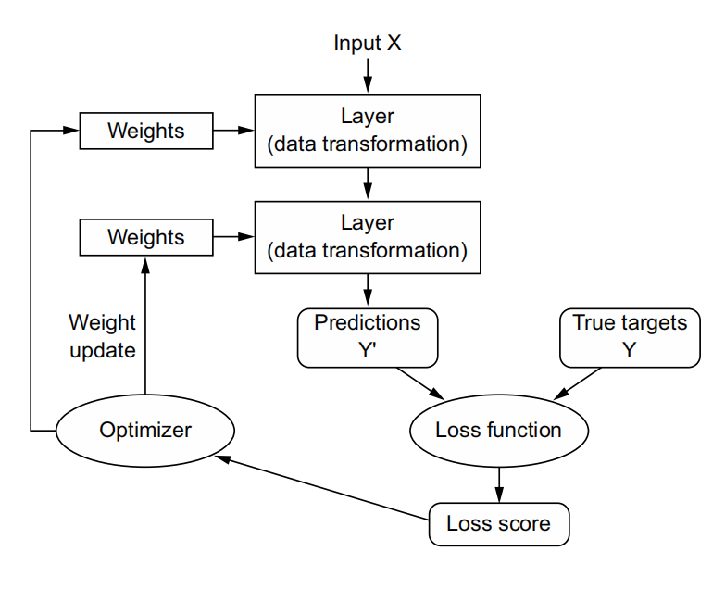
The concepts Learnt in previous classes
Gradient descent (a quick technique to calculate weight updates based on loss function)
Model initialization using ‘model.compile’ (initialization of hyper parameters, like optimizer, loss function, metrics)
Training Loop (model.fit)
Evaluation (model.evaluate)
Loss Function
Optimizer
Evaluation Metrics

Slide 6
Primary Types of Deep Learning
Binary classification A classification task where each input sample should be categorized into two exclusive categories.
Multiclass classification Classification task where each input sample should be categorized into more than two categories: for instance, classifying handwritten digits.
Multilabel classification A classification task where each input sample can be assigned multiple labels. For instance, a given image may contain both a cat and a dog and should be annotated both with the “cat” label and the “dog” label. The number of labels per image is usually variable.
Scalar regression A task where the target is a continuous scalar value. Predicting house prices is a good example: the different target prices form a continuous space.
Vector regression A task where the target is a set of continuous values: for example, a continuous vector. If you’re doing regression against multiple values (such as the coordinates of a bounding box in an image), then you’re doing vector regression.

Slide 7
Take Aways from 3 Experiments
Binary classification: - Output layer has one unit and a sigmoid activation - Loss function binary_crossentropy - Optimizer: Rmsprop / Adam - Lables encoding: 0,1
Single Class - Multiclass (N) Classification: - Ouput layer has N units, and a softmax activation (probability) - (It minimizes the distance between the probability distributions) - Lables can be encoded on OH-encoding, Loss function: Categorical crossentropy - Encoding the labels as integers, the loss fuction: Sparse_categorical_crossentropy
As a rule of thumb, the number of units in intermediate layers should not be less than Nto avoid information bottlenecks (mis representation of all classes)

Slide 8
Take Aways from 3 Experiments
Regression: Last layer have single unit, with Loss function as MSE, and no activation function. Evaluation metrics is mean absolute error (MAE). When features in the input data have values in different ranges, each feature should be scaled independently as a preprocessing step.
When there is little data available, using K-fold validation is a great way to reliably evaluate a model. When little training data is available, it’s preferable to use a small model with few intermediate layers (typically only one or two), in order to avoid severe overfitting.

Slide 9
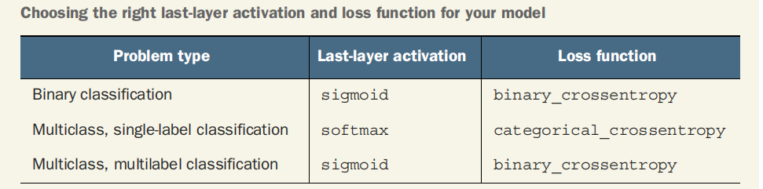

Slide 10
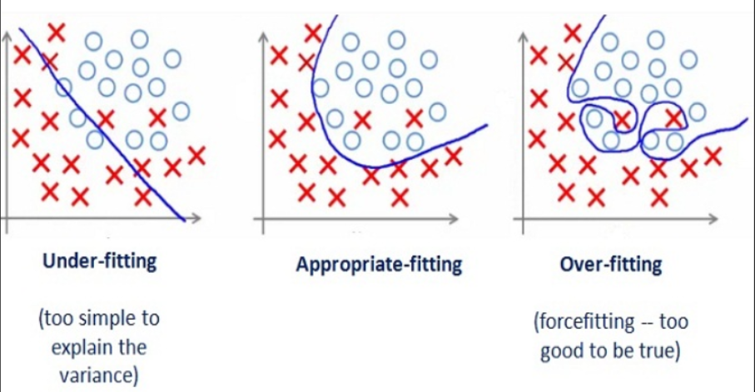
GENERALIZATION The goal of ML Avoiding Overfitting / Underfitting

Slide 11
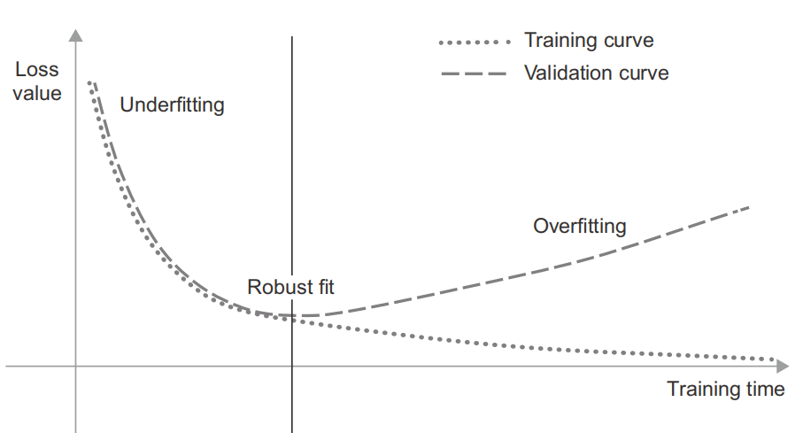
Robust Fit

Slide 12
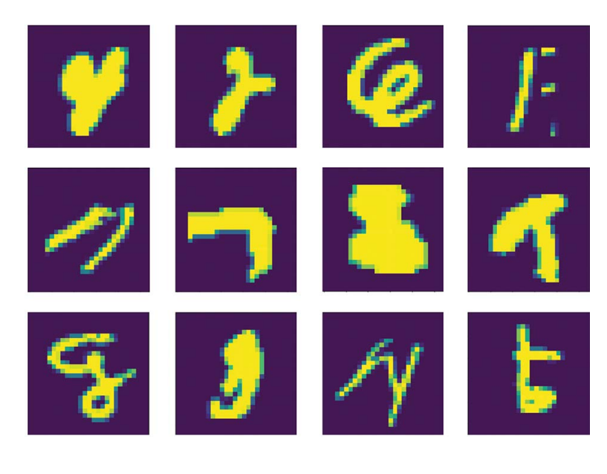
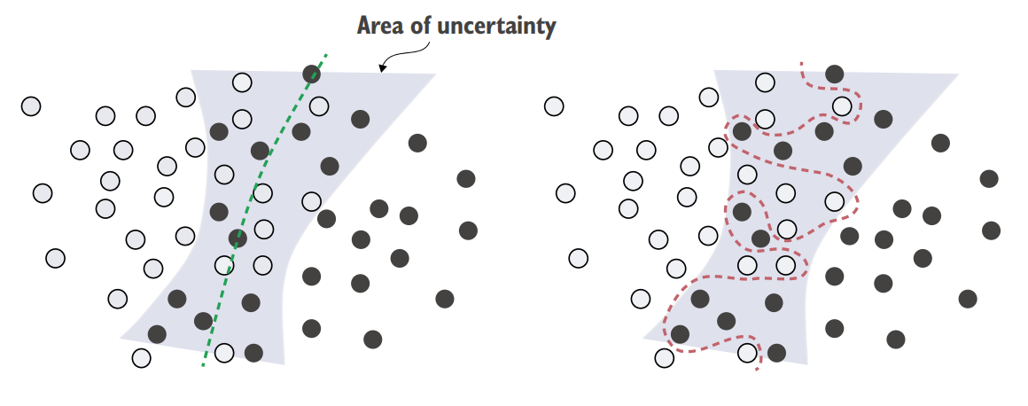
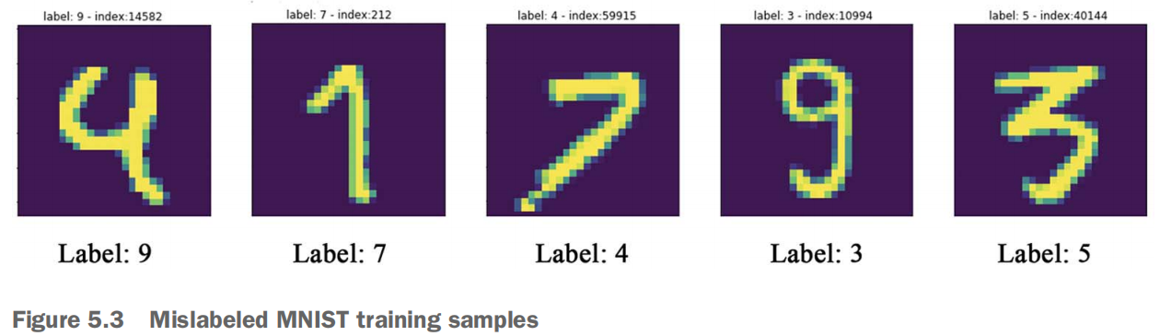
Reasons for Overfitting
NOISY TRAINING DATA
AMBIGOUS FEATURES
RARE FEATURES AND SPURIOUS CORRELATIONS
Notes:
givenexample of chabby cate, rare word, or words repeated across many classes

Slide 13
Manifold Analogy
A deep learning model is basically a very high-dimensional curve—a curve that is smooth and continuous (with additional constraints on its structure, originating from model architecture priors), since it needs to be differentiable.
And that curve is fitted to data points via gradient descent, smoothly and incrementally.
By its very nature, deep learning is about taking a big, complex curve—a manifold—and incrementally adjusting its parameters until it fits some training data points.
Moving along the curve learned by the model at that point will come close to moving along the actual latent manifold of the data—as such, the model will be capable of making sense of never-before-seen inputs via interpolation between training inputs

Slide 14
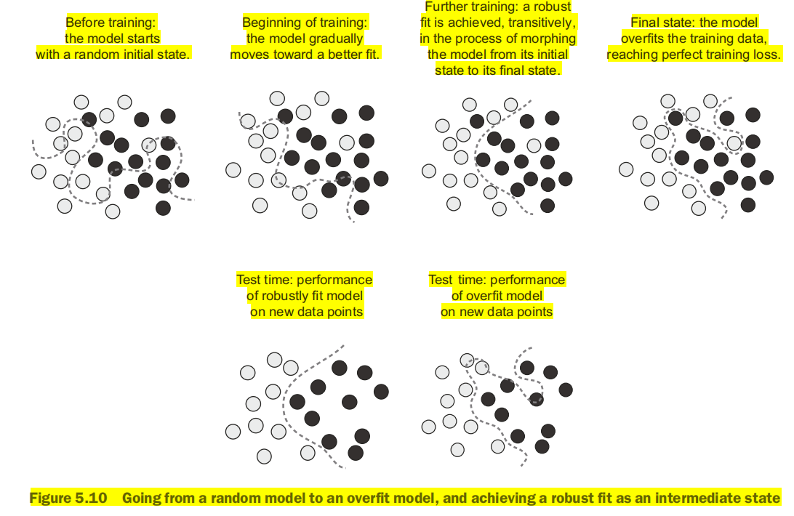

Slide 15
Model / Data Characterstics
Deep learning models implement a smooth, continuous mapping (mean differentiable - for gradient descent calc) essential for from their inputs to their outputs.
The more informative and the less noisy your features are, the better you will be able to generalize, since your input space will be simpler and better structured.
For the model to perform well it needs to be trained on a “dense sampling” of its input space (means that the training data should densely cover the entirety of the input data manifold)

Slide 16
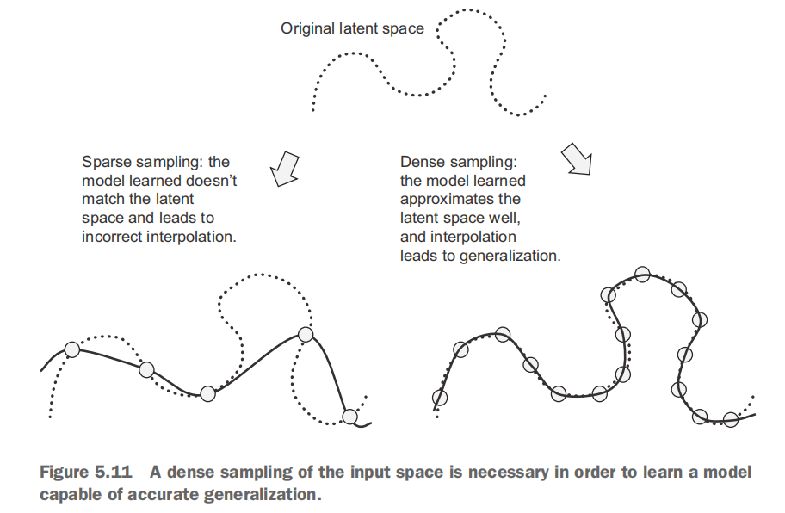
Dense Sampling & Interpolation

Slide 17
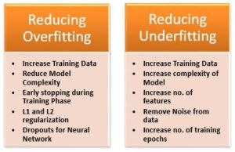
Ways to achieve Generalization

Slide 18
Informaton Leaks
The Train data should not be DUPLICATED in Validation/Test samples.
Every time you tune a hyperparameter of your model based on the model’s performance on the validation set, some information about the validation data leaks into the model -- AVOID REPEATING

Slide 19
Things to keep in mind about model evaluation
Data representativeness (train/validation data to have representation of all scenerios / classes -- that’s why we shuffle before splitting)
The arrow of time (shouldn’t shuffle the time-series data)
Redundancy in your data ( Make sure your training set and validation set are disjoint)

Slide 20
Common Observations in model fit.
Model at first must overfit, to know in advance where the boundary lies
There are three common problems you’ll encounter at this stage:
Training doesn’t get started: your training loss doesn’t go down over time.
Training and validation loss both go down over time, and you can beat your baseline, but you don’t seem to be able to overfit, which indicates you’re still underfitting.
Training gets started just fine, but your model doesn’t meaningfully generalize: you can’t beat the common-sense baseline you set.

Slide 21
Tuning Hyper Parameters
To fight these problems, you will be tuning the hyper parameters.
1. Tuning key gradient descent parameters * Learning Rate * Choice Optimizer (Gradient descent algorithm) (...) * Chosing Momentum with optimizer * Choice of Regularizations L1, L2, Dropout (to be discussed)
2. Increasing Model Capacity * Number of Layers * Number of unites in layers (both of these multiply to determine no. of model parameters/weights)
3. Others * Choice of Activation Function (...)

Slide 22
Dataset curation
Make sure you have enough data
Minimize labeling errors
Clean your data and deal with missing values
If you have many features and you aren’t sure which ones are actually useful, do feature selection.
Feature engineering (conversion of features to more learn-friendly ones)

Slide 23
Other ways to prevent over fitting
EARLY STOPPING: Finding the exact point during training where you’ve reached the most generalizable fit—the exact boundary between an underfit curve and an overfit curve—is one of the most effective things you can do to improve generalization.
REGULARIZATION: (panelty for loss function)
L1 -> L * sum(weights)
L2 -> L * sum(weights^2)
DROPOUT: dropping layers from calculation

